Slide 1


Predicting Mental Health in the workplace
Kristie kooken
Notes:
Hi, thank you for joining today. My name is Kristie Kooken, and I am going to present my data science project that I conducted to look at

Slide 2


Mental Health
1 out of 5 adults suffer from mental health illness (75.6M people)
Absent days:12 days versus 2 days
47.6B USD LOSS annually
In 2021
< 50% of those who suffer from mental illness seek treatment
Average delay of onset to treatment – 11 years

Slide 3




Background
mental health treatment is costly
202% Increase in a 20-year period
Affording costs of care is challenging
Medical coverage mandated
Mental health coverage is not
If other employees use employer benefits, more likely to use them as well

Slide 4
Purpose
To explore factors that can predict mental illness & attitudes about mental health in the workplace
To help employers know how to offer their employees a set of health care tools to deal with challenges such as mental health illness

Slide 5
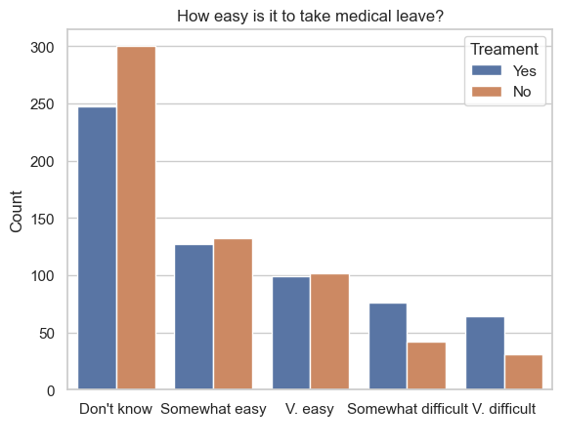
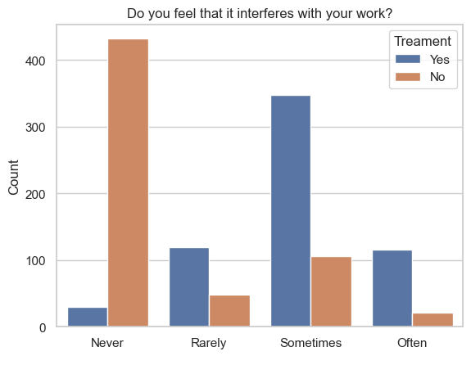
Analysis
Mental Health Survey, 2014
Exploratory Data Analysis
Tech industry
27 questions
Predictor: Sought Treatment?
26 independent variables
Data cleaning & wrangling using python
No outliers, missing data imputed for Interferes with work, duplicates dropped

Slide 6
Deeper DIVE into analysis
DUMMIED, any variable that had >2 categories was dummied
Grouped variables
Country and State
Base model
Logistic regression
Feature reduction
10 out of 45 features were dropped
Reduced model
Logistic regression
K-nearest neighbor
Random forest classification

Slide 7
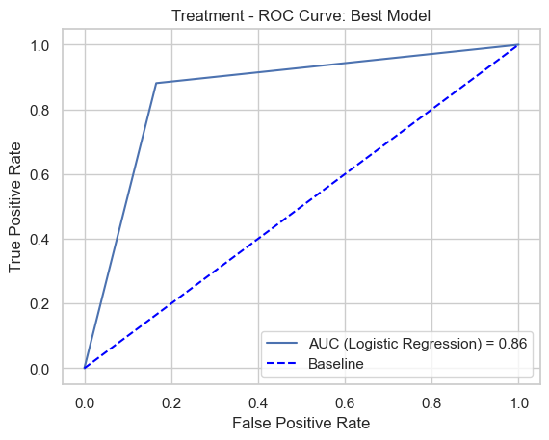
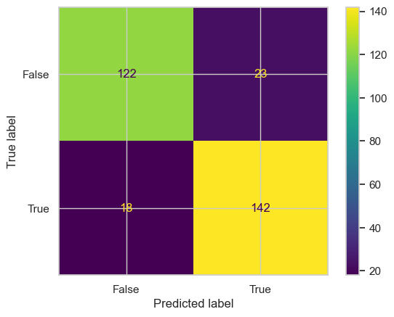
Model Results
87% accuracy
Precision and Recall were also acceptable
Ranging 0.89 to 0.84
Confusion Matrix

Slide 8

Conclusion
Overall model results within range for acceptability
Important features included:
Interferes with work
Would you be willing to discuss a mental health issue with your coworkers?
Family history
Do you know the options for mental health care your employer provides?
Does your employer provide mental health benefits?

Slide 9
CONSIDERATIONS
Scale development
Does scale demonstrate psychometric properties?
Sample is of Tech workers
Would other workers yield the same insights?
Sample mostly of U.S. workers
Additional characteristics should be considered
Benefit package quality
Other demographics such as Race, Dependents

Slide 10
Backup slides

Slide 11
Variables in analysis
Variable name | Variable description
Timestamp | Timestamp of survey
Age | Participant age
Gender | Participant gender
Country | Participant country
State | If you live in the United States, which state or territory do you live in?
self_employed | Are you self-employed?
family_history | Do you have a family history of mental illness?
treatment | Have you sought treatment for a mental health condition?
work_interfere | If you have a mental health condition, do you feel that it interferes with your work?
no_employees | How many employees does your company or organization have?
remote_work | Do you work remotely (outside of an office) at least 50% of the time?
tech_company | Is your employer primarily a tech company/organization?
benefits | Does your employer provide mental health benefits?
care_options | Do you know the options for mental health care your employer provides?
wellness_program | Has your employer ever discussed mental health as part of an employee wellness program?
seek_help | Does your employer provide resources to learn more about mental health issues and how to seek help?
anonymity | Is your anonymity protected if you choose to take advantage of mental health or substance abuse treatment resources?
leave | How easy is it for you to take medical leave for a mental health condition?
mental_health_consequence | Do you think that discussing a mental health issue with your employer would have negative consequences?
phys_health_consequence | Do you think that discussing a physical health issue with your employer would have negative consequences?
coworkers | Would you be willing to discuss a mental health issue with your coworkers?
supervisor | Would you be willing to discuss a mental health issue with your direct supervisor(s)?
mental_health_interview | Would you bring up a mental health issue with a potential employer in an interview?
phys_health_interview | Would you bring up a physical health issue with a potential employer in an interview?
mental_vs_physical | Do you feel that your employer takes mental health as seriously as physical health?
obs_consequence | Have you heard of or observed negative consequences for coworkers with mental health conditions in your workplace?
comments | Any additional notes or comments

